Slide 1
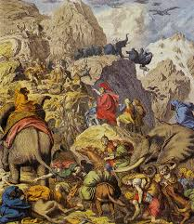

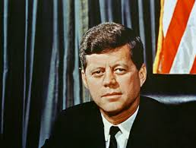
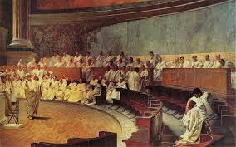

SPLASH
Learning from Great Leaders of the Past
By: Omar Khedr
Splash 2020

Slide 2
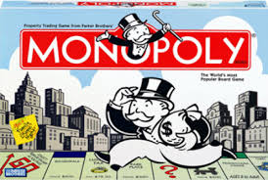
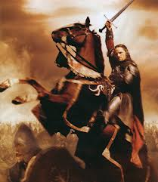
Leadership – Through the Ages

Slide 3

Leadership Pyramid Metric
Collaboration
Invent creative options
Connect their goals to their endowments
Understand the difference between Perception & Reality
Think Long Term
Rescope & Reanalyze the task
Creating Value & Claiming Value
Understand when to apply Soft & Hard Power
Generally Builders & Contributors to their Society

Slide 4
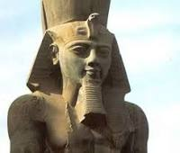
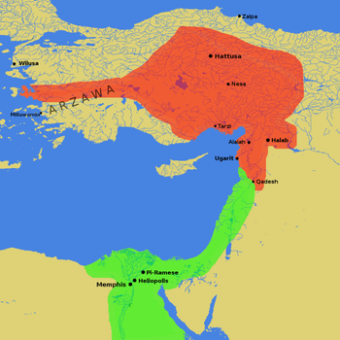
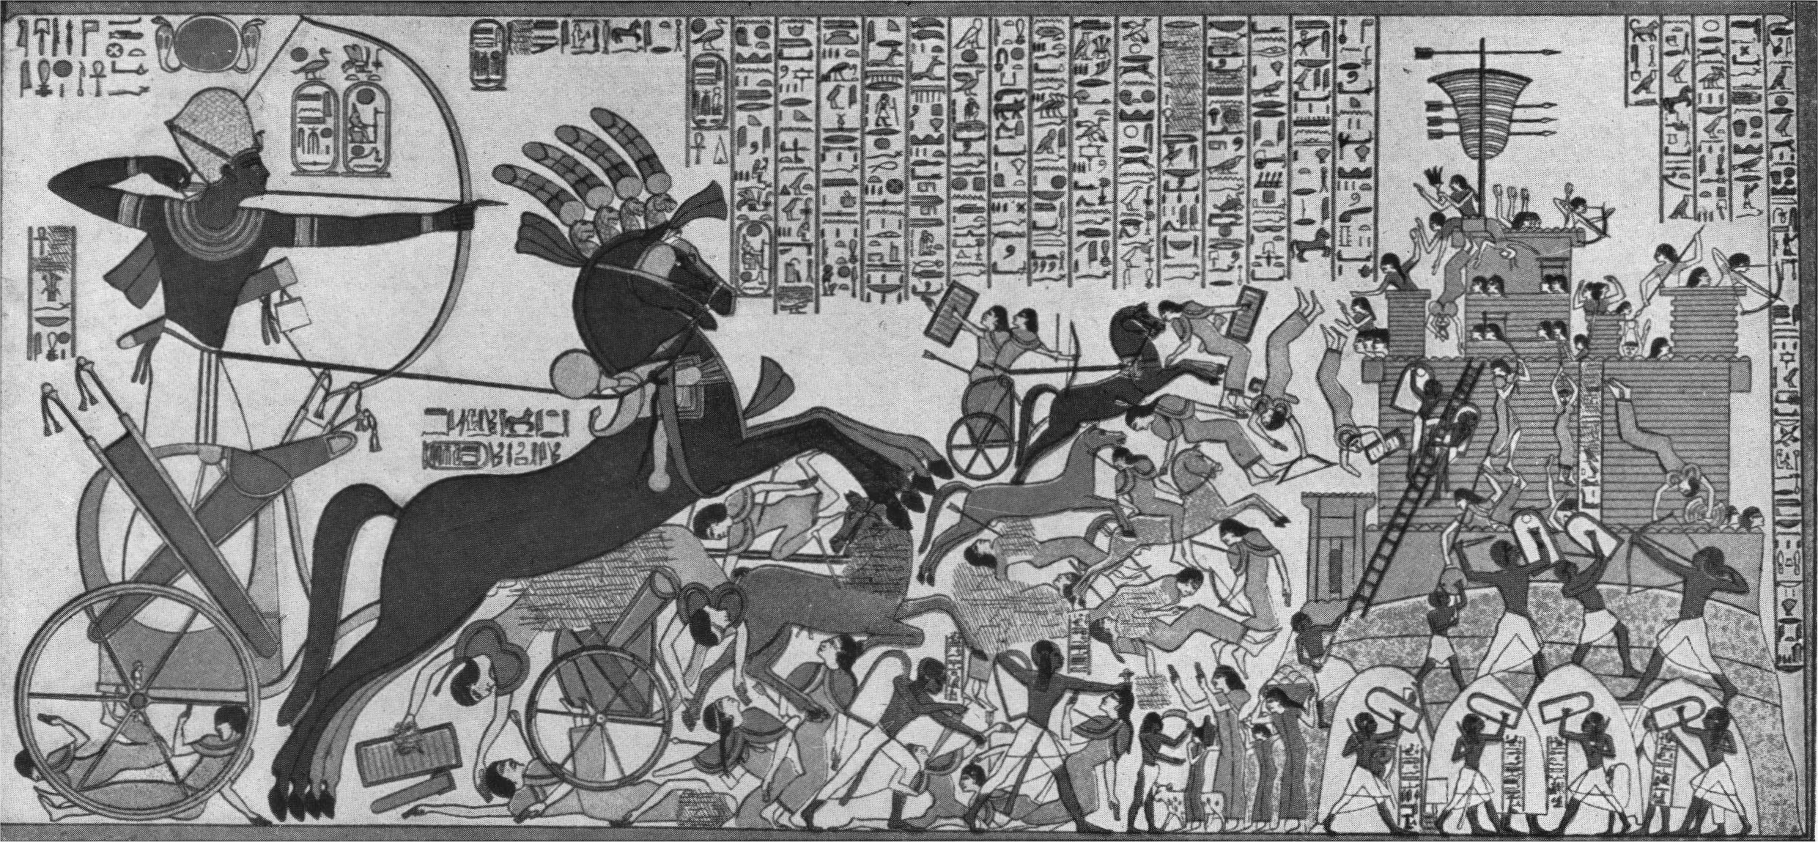
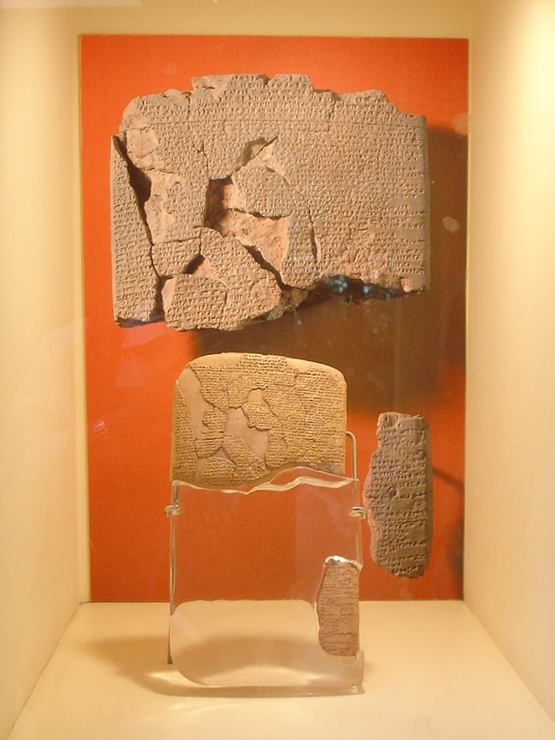
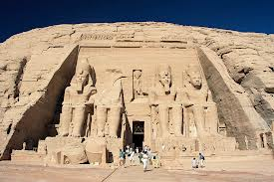
Accomplishments & Milestones
Questions to Ponder?
Why did Egypt view the Hittite Empire as an immediate and urgent security threat?
Was the negotiation of peace with the Hittites reasonable or could further conquest have been pursued?
Where there any cons to peace? “A bad peace is worse than war” – Tacitus Roman Senator
Solidified the Unity of the Egyptian Empire
Strengthened the capabilities of his armed forces while pursuing strong public investment into the economy through massive building projects
Took full advantage of the Battle of Kadesh (Stalemate) – portraying it as a victory within his own borders & negotiating with the Hittite Empire the world’s first international Peace Treaty
Ramesses II
Life: 1303 BC – 1213 BC
Leadership Influencer:
1279 -1213 BC

Slide 5

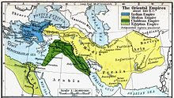

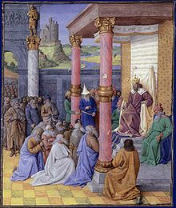
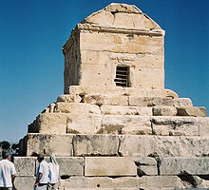
Accomplishments & Milestones
Questions to Ponder?
Why did Cyrus the Great show such religious tolerance? And was it the best course of action for his conquests?
How did the perception of religious tolerance & freedom endear him to his local conquered subjects
Laid the foundation for the Achaemenid Empire through his conquests
Pursued a practice of religious tolerance ahead of his time – Cyrus Cylinder
Built his economy through public infrastructure spending around the heart of this empire while investing transportation infrastructure so that his conquered cities could have lower transportation costs for themselves
Cyrus the Great
Life: 576 BC – 530 BC
Leadership Influencer:
559BC - 530BC
“And those who were subject to him, he treated with esteem and regard, as if they were his own children, while his subjects themselves respected Cyrus as their "Father" ... What other man but 'Cyrus', after having overturned an empire, ever died with the title of "The Father" from the people whom he had brought under his power? For it is plain fact that this is a name for one that bestows, rather than for one that takes away!” – Xenophon
Father of History & Greek Historian

Slide 6
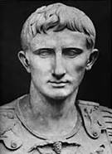

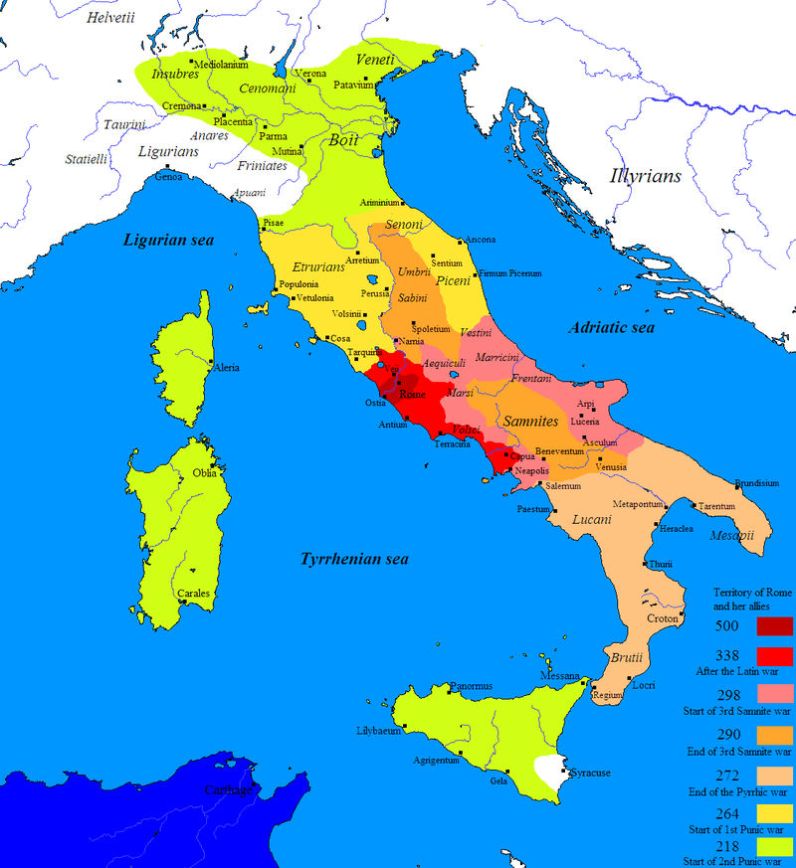
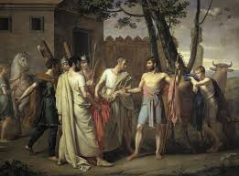
Accomplishments & Milestones
Questions to Ponder?
What was the significance of the handing power over to the Senate after his dictatorship period ended?
How did this transition set the stage, set the expectations, and the precedent for future military leaders?
Served as Roman Dictator twice retiring to civilian life afterwards in both occasions
Expanded the Roman Republic’s area of influence in the Italian Peninsula
Strengthened the fighting capabilities of the Roman Army through structural & organizational reforms
Lucius Cincinnatus
Life: 519 BC – 430 BC
Leadership Influencer:
458BC - 439BC
You have often heard him compared to Cincinnatus," the French traveller Jacques-Pierre Brissot de Warville wrote after visiting George Washington at Mount Vernon in 1788.

Slide 7
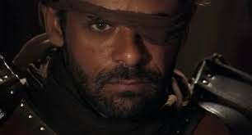
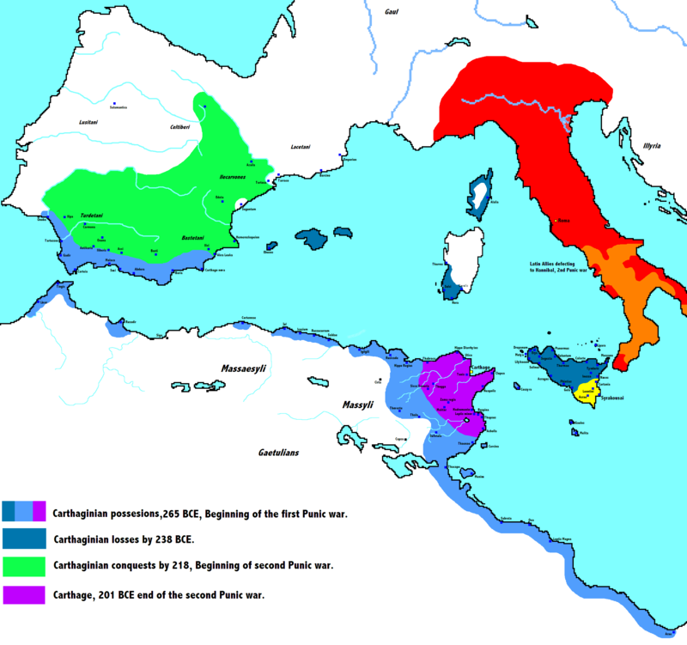
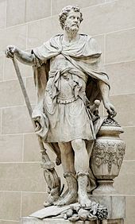
Accomplishments & Milestones
Questions to Ponder?
Contemplating the march across the Alps, what are some of the logistical & motivational challenges that Hannibal had to overcome?
While his military career was brilliant through the Second Punic War, it ended in Carthage’s defeat against Rome. Was Hannibal’s decision not to attack Rome a fatal mistake?
Marched his entire army from Southern Spain into Italy through the Alps in Winter – A military feat that had never been done before
Won three major battles against the Roman armies in Italy before deciding not to attack Rome itself
Rebuilt the prosperity of Carthage after the Second Punic War before entering into voluntary exile
Hannibal
Life: 247 BC – 181 BC
Leadership Influencer:
221BC -181BC
You, Hannibal, know how to gain a victory; but you do not know how to use it.“
-Maharbal
General in Hannibal’s Army

Slide 8
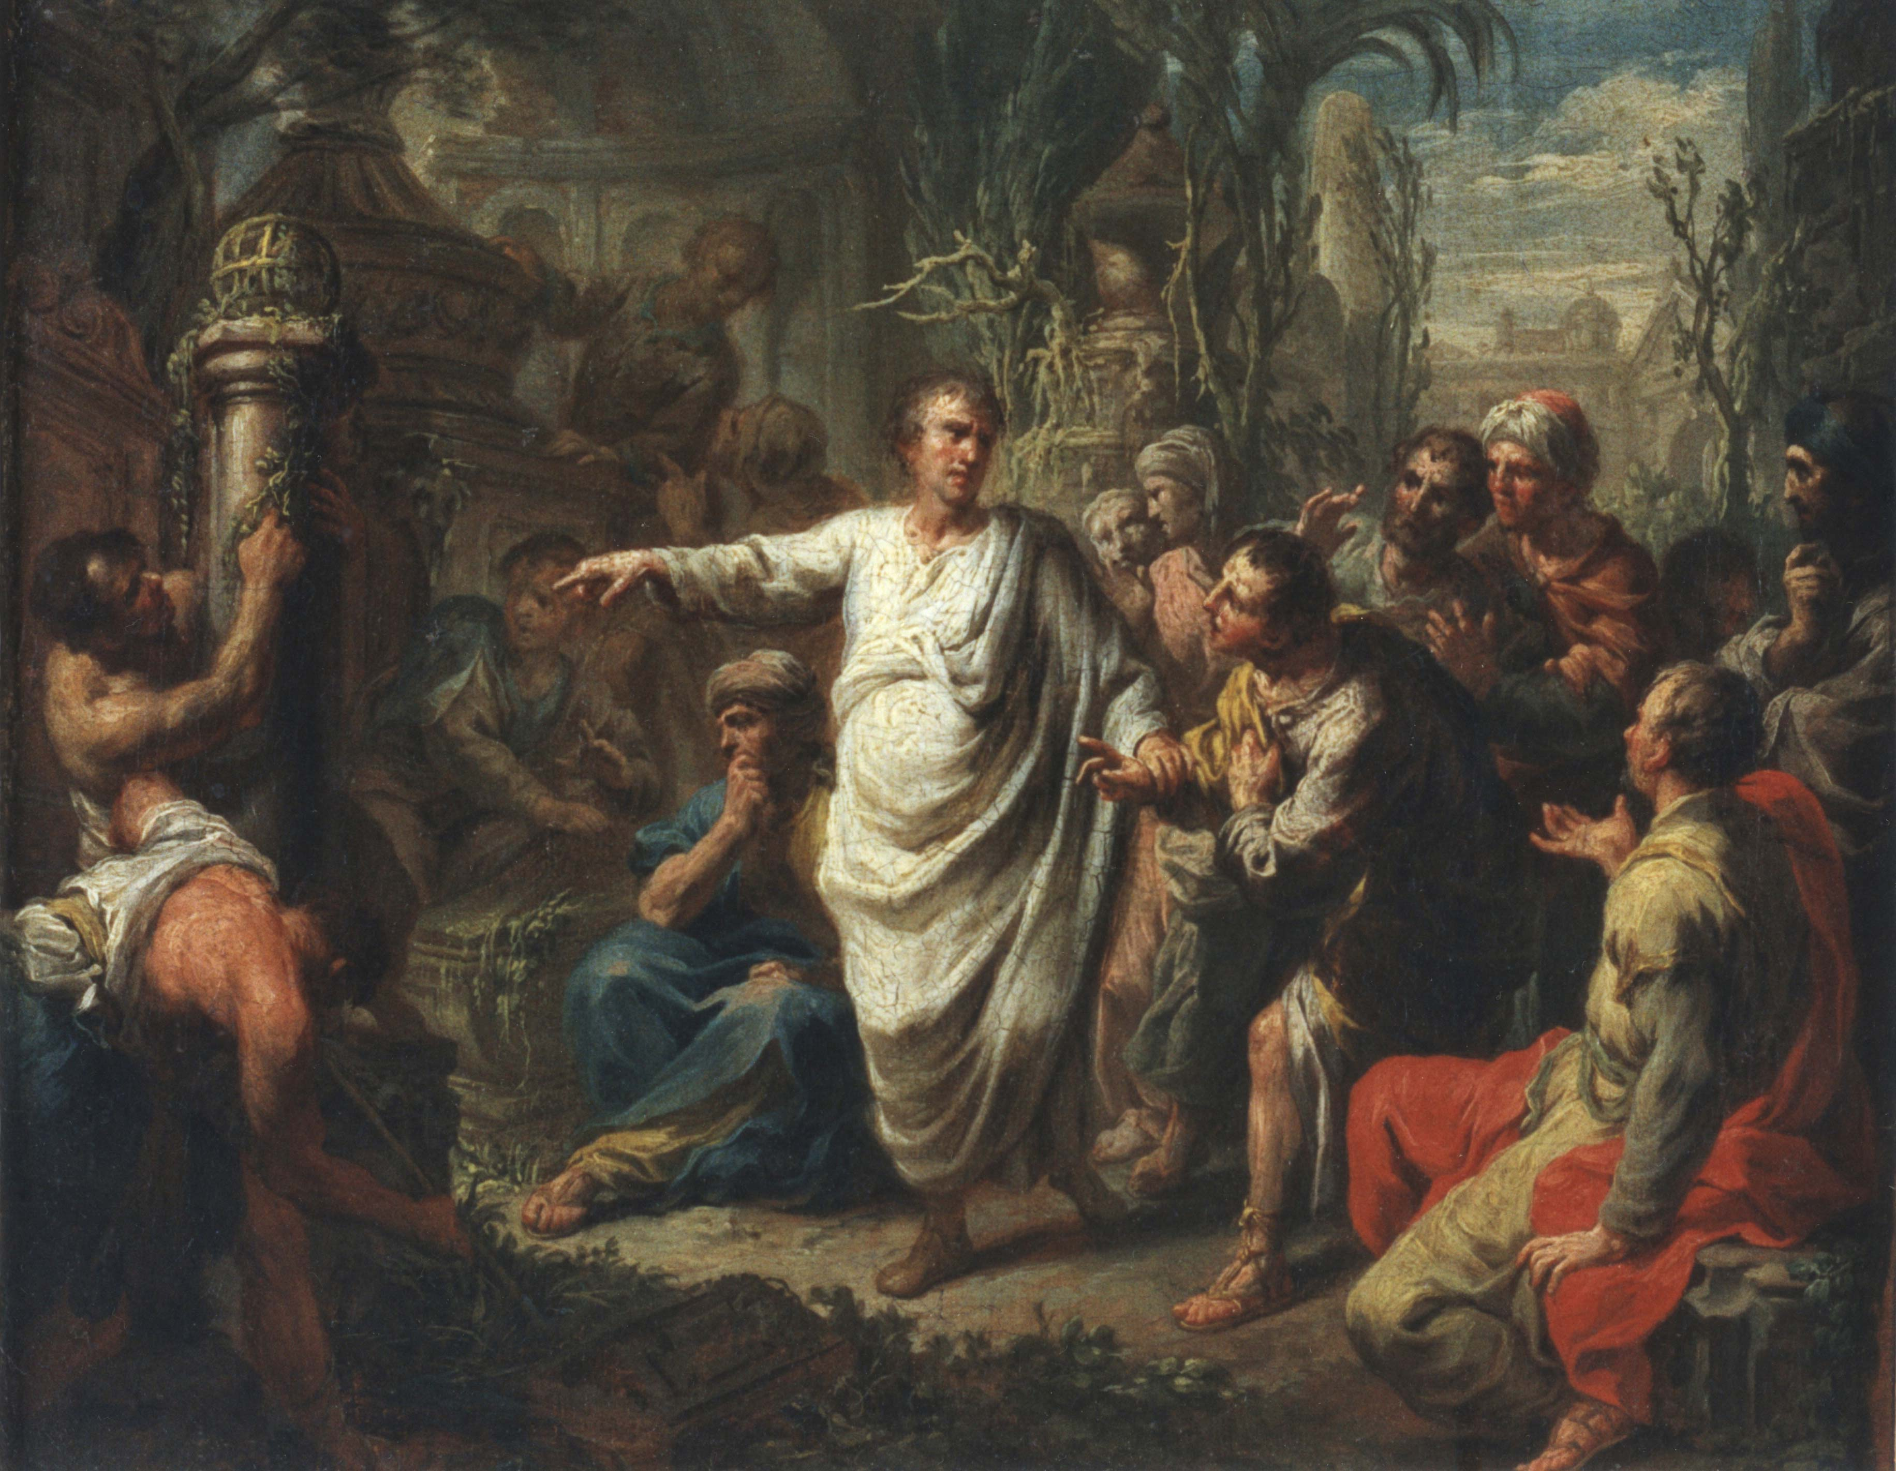
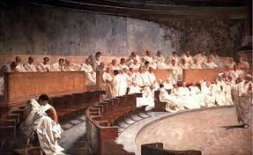
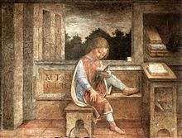
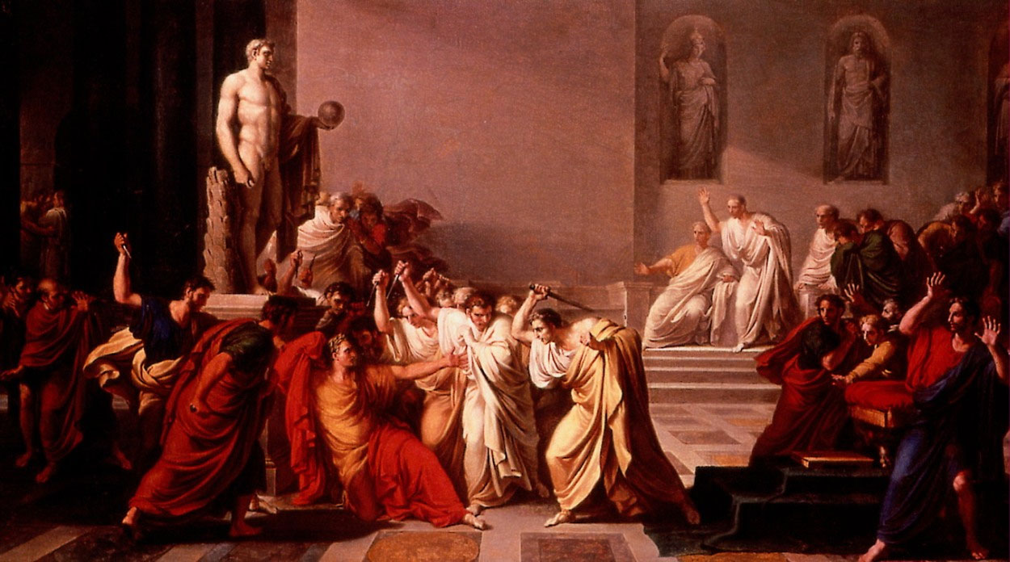
Accomplishments & Milestones
Questions to Ponder?
The power to mobilize and inspire individuals to action through words was Cicero’s hallmark, what in your mind would have been the essential themes he would have tapped into to connect with his audience?
Was his open and repetitive challenges to Mark Anthony a strategic blunder or a heroic defense of the Republic?
Reached the position of Consul and helped prevent an overthrow of the Roman Republic - utilizing the power of his words in four famous speeches (Catiline Orations) to drive the conspirators out of Rome
Major contributor to Roman Philosophy & Political Theory – 6 of his books and 58 of his speeches have survived
He was an open challenger to Mark Anthony, hoping to preserve the Roman Republic – led to his death
Cicero
Life: 106 BC – 43 BC
Leadership Influencer:
63BC -43BC
Augustus banned Cicero's works. One day, according to the Roman biographer Plutarch, Augustus caught his grandson reading one of Cicero's books. Augustus took the book from the boy and read from it for a long time. He then said, "My dear child, this was an eloquent man, and a patriot."

Slide 9

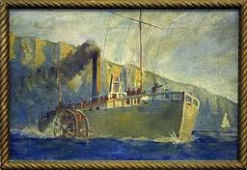
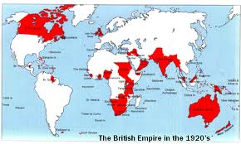
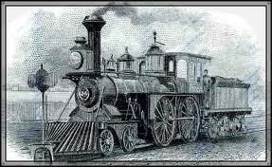
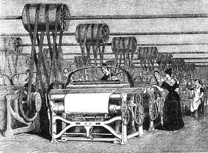
Post – Antiquity

Slide 10
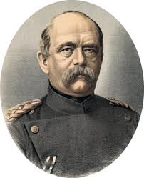
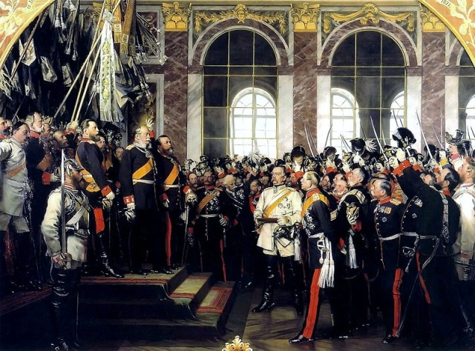
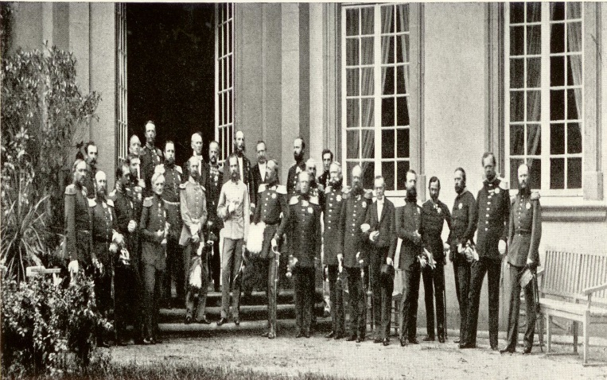
Accomplishments & Milestones
Questions to Ponder?
Did Bismarck's epic success for Germany also lay the foundations for WWI with a France that was desperate to regain its lost honor
Although widely hailed as brilliant, what are some of the risks that you can see in Bismarck's strategy of testing the strength of the German Alliances through war with France?
Driving force behind German Unification leading to the formation of a single German Empire with the Kaiser as the Head of State
His gradual unification of the German principalities with their leaders retaining limited power is still studied among experts in international relations
Seized upon the Franco – Prussian War as the banner behind which German States & Confederations could unify under
Otto Von Bismark
Life: 1815 -1898
Leadership Influencer:
1862 - 1890
“Realpolitik for Bismarck depended on flexibility and on the ability to exploit every available option without the constraint of ideology.” – Henry Kissenger

Slide 11
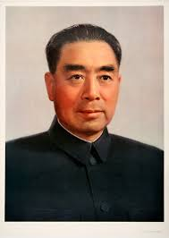
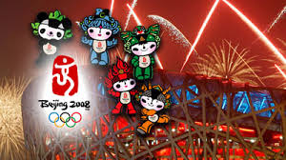
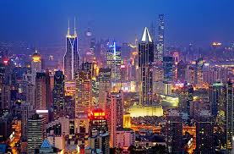
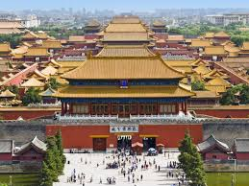
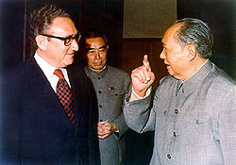
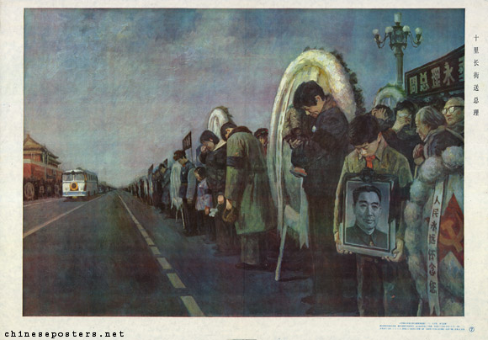
Questions to Ponder?
Accomplishments & Milestones
Why do you think China shifted away from the USSR towards the United States?
Although Zhou Enlai saved the forbidden city from being demolished, many accused him of not doing enough at the start of the Cultural Revolution and defying Mao Zedong enough. To what extent can a subordinate in your mind challenge his superior, and what are red lines?
Premier under Mao Zedong, who brought about opening of relations between China and the United Nations First (Unseating Taiwan from the Security Council) and then laying the foundation for opening of relations with USA
His stance against the Red Guards attempt to destroy the Forbidden City is hailed as preservation of China’s rich history
His ability to work with different political factions during the Second World War while keeping perspective for the long term allowed the Communist Party to be a strong position post-WWII
Zhou Enlai
Life: 1898 – 1976
Leadership Influencer:
1956 -1966 & 1973 - 1976
“It is a little bit humiliating when I have to say that Zhou Enlai to me appears as the most superior brain I have so far met in the field of foreign politics... so much more dangerous than you imagine because he is so much better a man than you have ever admitted.” – Dag Hammarskjold
UN Secretary General

Slide 12

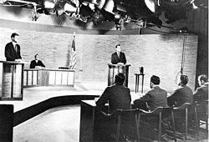
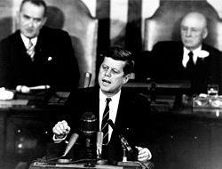
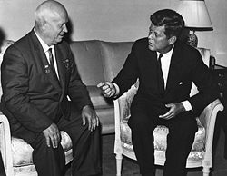

Questions to Ponder?
Accomplishments & Milestones
Was the Bay of Pigs invasion a disaster in planning, coordination, or overconfidence? Or was it all of these combined?
In your minds, what were some of the key messages that President Kennedy had to convey to the leaders of the USSR during the Cuban Missile Crisis? Should it all have been sticks or could carrots also have worked?
Became the first catholic and heritage President of the United States defeating Richard Nixon in the election which saw the first TV Presidential debate
His handling of the Bay of Pigs invasion is considered a low point, but his ability to diffuse the Cuban Missile Crisis was instrumental in preserving world peace
He inspired an aggressive expansion of the US Space Program which culminated after his death with USA being the first country to land a person in the moon
John F. Kennedy
Life:1917 -1963
Leadership Influencer:
1956 -1963
“We choose to go to the moon in this decade and do the other things, not because they are easy, but because they are hard, because that goal will serve to organize and measure the best of our energies and skills, because that challenge is one that we are willing to accept, one we are unwilling to postpone, and one which we intend to win.” – President Kennedy

Slide 13
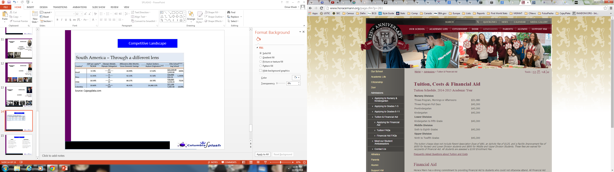
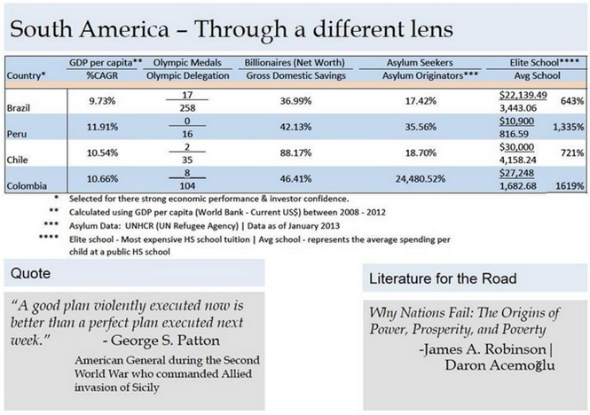
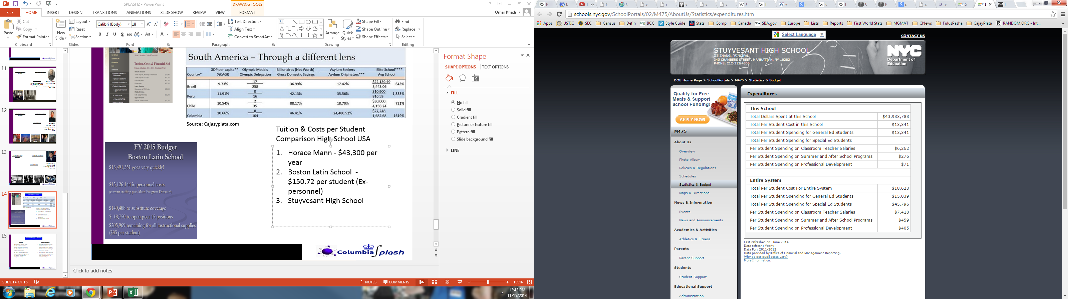
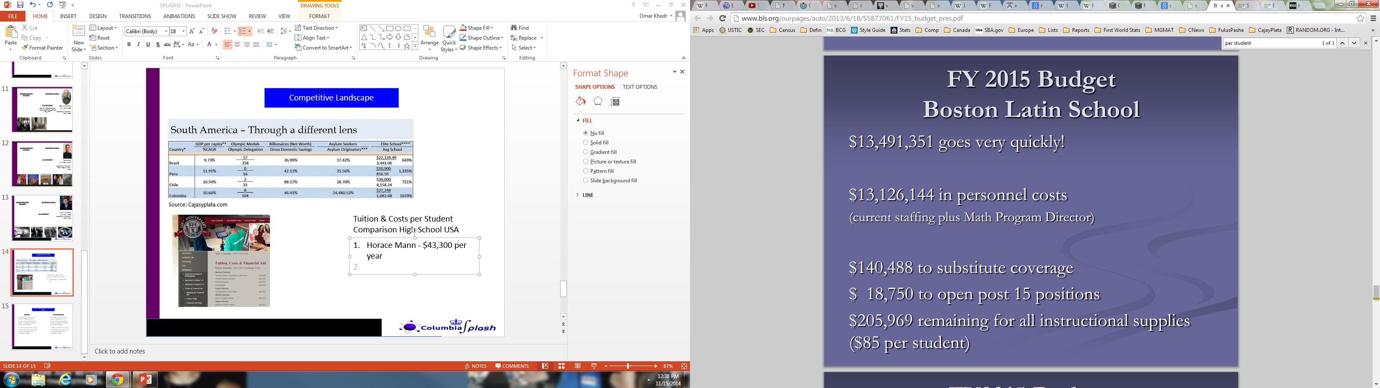
Competitive Landscape
Source: Cajasyplata.com
Tuition & Costs per Student Comparison High School USA
Horace Mann - $43,300 per year
Boston Latin School -
$150.72 per student (Ex-personnel) or NYC method
$5,568 per student
Stuyvesant High School –
$7,079 per student (Ex-teachers but not admin, infra & other expenses) NYC Method - $7,079

Slide 14
Interesting Readings & Places to Learn
Readings
Online Resources
NYTimes
Economist
Wall Street Journal / Financial Times
Foreign Affairs
Harvard Business Review
Coursera
Khan Academy
MIT Opencourseware
World Economic Forum
Clinton Global Initiative
Munich Security Conference
Activities
Sports – PSAL League
Asphalt Green Club
Global Kids
Model UN
Mind Matters
Form your own Activity!

